Slide 1






Export Marketing Plan Presentation
Global Exporter Passport Programme (GEPP)
Presented by:
[Presenter's Name]
Business Name
15-Minute Presentation | 15-Minute Q&A Session
Notes:
Presenter's Guide: Slide 1 - The Introduction
Objective: To make a strong, professional first impression.
Action: State your name, your company's name, and the purpose of your presentation clearly.
Timing: Spend no more than 30 seconds on this slide.
Tip: This is your title slide. Keep it clean and professional. Ensure your company name is prominently displayed. This sets the stage for the entire presentation.

Slide 2








The Big Picture
Company Overview
Market Entry Strategy
[Company Name] is poised to capitalize on a significant export opportunity in [Target Market Country] with our [Product/Service for Export].
We are positioned to leverage our company's unique strengths in [specific areas] to address the identified market needs in [Target Market Country].
Our comprehensive plan outlines a clear path to market entry, sustainable growth, and profitability, leveraging our unique strengths to meet the identified market demand.
Our approach combines [key strategies] to ensure a strong market entry while maintaining control over our brand and customer relationships.
Growth Potential
Our Competitive Edge
The [Target Market Country] market shows significant growth potential with [specific data points from DOC].
Unique Product/Service offering
Strong Production Capacity
Our scalable business model and proven product success in domestic markets position us for sustainable growth and profitability.
Established Domestic Success
These strengths differentiate us from competitors and position us for success in the international market.
2 / 16
Notes:
Presenter's Guide: Slide 2 - The Executive Summary
Objective: To provide a high-level overview of your entire plan, capturing the panel's interest immediately.
Source: This slide is a verbal delivery of the Executive Summary from your Assignment 3 (Export Marketing Plan).
Content Focus: Briefly introduce your company, the product, the target market, and why this is a compelling opportunity. Highlight your three main competitive advantages.
Timing: Allocate approximately 60-90 seconds. This is your "elevator pitch."
Tip: Be confident and concise. You are telling the panel *what* you are going to do; the following slides will explain *how* and *why*.

Slide 3












Company Export Readiness
Our company is well-positioned for export due to several key strengths that differentiate us in the global marketplace.
Unique Product
Production Capacity
Domestic Success
Our innovative [eco-friendly packaging solutions] set us apart from competitors.
Ability to scale production by 50% within 6 months to meet international demand.
Proven track record of 10 years in the domestic market with a 20% annual growth rate.
Patented technology
Flexible manufacturing
Strong brand recognition
Sustainable materials
Experienced workforce
Customer loyalty
Superior quality control
Strategic partnerships
Market expertise
Core Business
International Readiness
Manufacturing high-quality artisanal food products with a focus on sustainability.
Internal analysis confirms we have the necessary resources, expertise, and product offering for international markets.
3 / 16
Notes:
Presenter's Guide: Slide 3 - Proving Your Capability
Objective: To build credibility by demonstrating your company has the internal foundation for export success.
Source: Pull directly from the Strengths section of your SWOT Analysis (Assignment 1) and the "Company Overview" section of your Export Marketing Plan (Assignment 3).
Content Focus: Use quantifiable data. Instead of saying "good growth," say "20% annual growth rate." Showcase what makes your product special and prove you can meet increased demand.
Timing: Spend about 60 seconds here. Touch on each of the three pillars.

Slide 4








Why Export Now?
Our internal analysis confirms we have the necessary resources, expertise, and a robust product offering that aligns with identified international market needs.
Unique Product/Service
Strong Production Capacity
Established Domestic Success
Our innovative, eco-friendly packaging solutions fill a gap in the [Target Market Country] market.
Ability to scale production by 50% within 6 months to meet international demand.
A proven track record of 10 years in the domestic market with a 20% annual growth rate.
Ready to Go International
With our core business established and internal analysis confirming our readiness, we are prepared to capitalize on the export opportunity in [Target Market Country] at this time.
4 / 16
Notes:
Presenter's Guide: Slide 4 - Justifying the Timing
Objective: To create a sense of urgency and strategic timing. Answer the question: "Why is this the right moment?"
Source: Synthesize your SWOT Analysis (Assignment 1) and the "Export Goals and Objectives" from your Export Marketing Plan (Assignment 3).
Content Focus: Frame your argument around two key themes: "Market Pull" (the market is ready for you) and "Company Push" (you are ready for the market). This shows a convergence of opportunity and readiness.
Timing: 60 seconds. This slide should feel like a confident conclusion to your internal analysis.

Slide 5









Target Market Selection
Target Country
Customer Segment
Our primary target market is [Chosen Country].
We will focus on [Specific Customer Segment].
This selection is based on comprehensive market research and analysis of export opportunities.
This segment shows the highest potential for our product and aligns with our core business focus.
Market Research Justification
Market Size
Consumer Need
Logistics
The market for [product type] in [Chosen Country] is projected to reach [$500 million] by [year].
Strong demand for [specific need/preference] among the target segment, which our product directly addresses.
Well-developed port and road network, facilitating efficient distribution to target markets.
5 / 16
Notes:
Presenter's Guide: Slide 5 - Where and To Whom
Objective: To clearly state your target market and provide a data-backed rationale for this choice.
Source: This is a summary of your Market Research Report (Assignment 2) and the "Target Market Analysis" section of your Export Marketing Plan (Assignment 3).
Content Focus: Be specific. Name the country and the customer segment (e.g., "Health-conscious millennials in urban Germany"). Use the three justification points (Market Size, Consumer Need, Logistics) as your core argument.
Timing: 60-75 seconds. State your choice, then quickly provide the evidence.

Slide 6





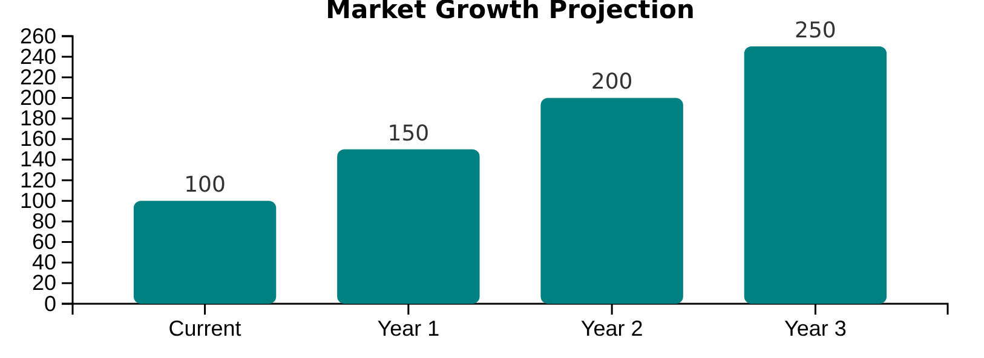



Market Size & Growth Potential
Significant Market Size
Growing Consumer Need
The market for [product type] in [Chosen Country] is projected to reach $500 million by [year].
Our research shows increasing demand among the target segment for convenient, healthy, and ethically sourced products that meet specific needs, creating a strong market opportunity.
Favorable Logistics Infrastructure
The target market possesses a well-developed port and road network, facilitating efficient distribution.
Port Access
Road Network
Distribution
6 / 16
Notes:
Presenter's Guide: Slide 6 - Visualizing the Opportunity
Objective: To visually reinforce the market opportunity you just described.
Source: Use the most compelling charts and images from your Market Research Report (Assignment 2).
Content Focus: A picture is worth a thousand words. Show a graph of market growth. Use images that represent your target consumer or the logistical advantages. Don't just read the text; use the visuals to tell the story.
Timing: 45-60 seconds. Let the visuals do most of the talking.

Slide 7







Our Competitive Advantage
Unique Selling Proposition
Our USP in [Target Market Country] is "[State USP]". This differentiates us from competitors.
VS
Local Competitors
International Competitors
Lack sustainable certifications
Lower quality
Higher prices
Less local flavor adaptation
Lack sustainable certifications
Lower quality
Higher prices
Less local flavor adaptation
Why We Stand Out
We offer products that meet quality standards while resonating with growing consumer preference for environmentally responsible brands.
7 / 16
Notes:
Presenter's Guide: Slide 7 - Defining Your Edge
Objective: To clearly articulate why customers will choose you over the competition.
Source: This is a direct summary of the "Competitor Analysis" section from your Market Research (Assignment 2) and your defined USP from Assignment 3.
Content Focus: Start with your powerful USP statement. Then, use the two-column format to create a direct comparison against your rivals. Focus on their weaknesses that your product solves.
Timing: 60 seconds. Be sharp and confident in your positioning.

Slide 8











Market Entry Strategy
Direct Exporting Approach
Our chosen market entry method is direct exporting via a local distributor in
Optimal given our company's current resources and limited export experience
Leverages distributor's established network and local market expertise
Maintains reasonable control over brand and customer relationships
Distribution Channel Flow
Freight Forwarder
Local
Distributor
Retailers
Consumer
Factory
8 / 16
Notes:
Presenter's Guide: Slide 8 - The "How" of Market Entry
Objective: To explain your chosen method for entering the market and justify why it's the right choice for your company.
Source: Refer to the "Market Entry Strategy" section of your Export Marketing Plan (Assignment 3). This aligns with US 243215, SO1.
Content Focus: Clearly state your method (e.g., "Direct Exporting via a Distributor"). Your justification should be concise and address risk, control, and resource commitment. The flowchart is an excellent way to visually explain the process.
Timing: 60 seconds. The panel needs to see that you've thought through the practicalities of getting your product to market.

Slide 9












Product Adaptation Strategy
Our product strategy involves specific adaptations to meet the target market's needs and preferences, ensuring successful market entry and consumer acceptance.
Packaging Size
Label Language
Product Feature
Introducing 500g unit in addition to 1kg unit
Compliance with local regulations
Based on taste tests showing preference for a more robust flavor
Based on feedback indicating preference for smaller, more affordable trial sizes
Improved consumer understanding of product features
Meeting local taste preferences while maintaining product quality
Reduced initial commitment for potential customers
Compliance with local regulations
Based on taste tests showing preference for a more robust flavor
Reduced initial commitment for potential customers
Improved consumer understanding of product features
Meeting local taste preferences while maintaining product quality
Reduced initial commitment for potential customers
These adaptations are based on market research and consumer feedback to ensure optimal product acceptance in the target market.
9 / 16
Notes:
Presenter's Guide: Slide 9 - Meeting Local Needs
Objective: To demonstrate that you've done your homework and are adapting your product to fit the target market, rather than just selling a domestic product abroad.
Source: This comes directly from the "Product Strategy" section of your Export Marketing Plan (Assignment 3), which was informed by your "Product Viability Test" in Assignment 2. This addresses US 243215, SO2.
Content Focus: Be specific about the changes. Highlighting 2-3 key adaptations is more powerful than a long list. Emphasize that these changes are data-driven ("based on feedback/taste tests").
Timing: 60 seconds. Show the panel you are customer-centric and responsive to market needs.

Slide 10






Pricing Strategy
Pricing Objective
Free Carrier
Primary Focus
Ex Works - Price
What is FCA?
Our primary pricing objective is market penetration to gain initial market share in [Target Market Country].
USD 80/unit
Free Carrier designation indicating delivery to the port of Durban/terminal/warehouse.
EXW: Address
Incoterms® 2020
Strategy Highlights
Key Implications
Competitive pricing to attract initial customers
Seller covers costs until goods reach port
Value-focused approach to justify premium positioning
Final Quoted Price
Buyer responsible for shipping and insurance
Strategic pricing to build market presence
USD 100/unit
FCA - Free Carrier: Address
Incoterms® 2020
10 / 16
Notes:
Presenter's Guide: Slide 10 - The Financials of the Sale
Objective: To explain your pricing logic and the commercial terms of sale.
Source: Use the "Pricing and Costing Strategy" section from your Export Marketing Plan (Assignment 3). This addresses US 243215, SO3 and US 252437.
Content Focus: Clearly state your objective (e.g., Penetration, Skimming). Explain your chosen Incoterm and why it's suitable (e.g., "FCA gives us control over domestic costs while allowing the experienced buyer to manage international freight").
Timing: 60-75 seconds. The panel will be very interested in your commercial acumen.

Slide 11







Promotional Activities
To create awareness and generate leads in the first year, we will undertake the following key promotional activities:
Targeted Digital Advertising
Trade Show Participation
Introductory Discounts
Running targeted ads on a local industry website
Participating in a key local trade show
Offering introductory discounts for first-time distributors
Engaging directly with potential distributors and retailers
Social media campaign aimed at importers and end-consumers
Incentivizing initial orders to build strong partnerships
Setting up an attractive booth to showcase our products
Creating digital content to build brand awareness
Creating promotional packages for new customers
Expected Outcomes:
These activities are expected to generate initial market awareness, establish key partnerships, and create a foundation for long-term brand loyalty in the [Target Market Country].
11 / 16
Notes:
Presenter's Guide: Slide 11 - Creating Market Buzz
Objective: To show the panel you have a concrete plan to generate awareness and sales.
Source: Pull from the "Promotion Strategy" section of your Export Marketing Plan (Assignment 3). This addresses US 243215, SO4.
Content Focus: Focus on 2-3 high-impact activities for the first year. Be specific where possible (e.g., name the trade show you plan to attend). Link these activities to your expected outcomes.
Timing: 60 seconds. Demonstrate a clear, focused, and budgeted approach to promotion.

Slide 12


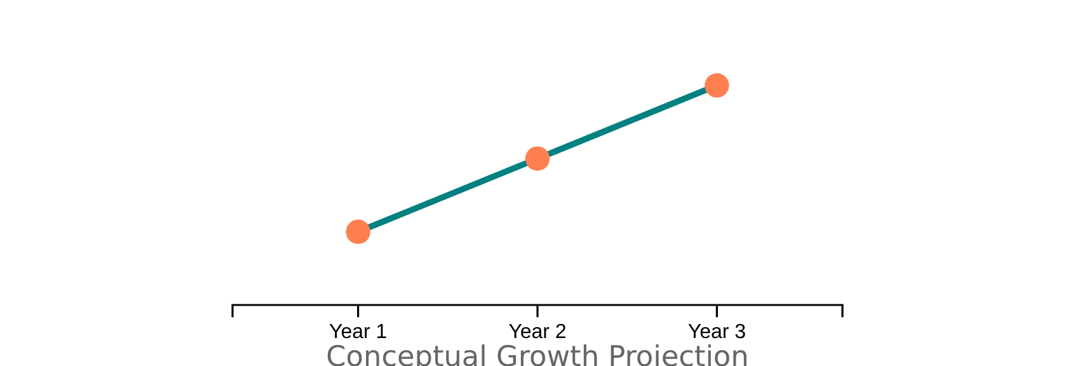
3-Year Financial Projections
This section outlines the expected financial outcomes and resources required for the export venture over a 3-year period.
Metric
Year 1 (Projected)
Year 2 (Projected)
Year 3 (Projected)
Projected Unit Sales
[Number]
[Number]
[Number]
Projected Revenue (in quote currency)
[Currency Amount]
[Currency Amount]
[Currency Amount]
Total Year 1 Export Budget
[Currency Amount]
N/A
N/A
Break-Even Point (Units)
[Number]
N/A
N/A
Sales Growth Projection
Key Financial Insights
Sales forecast based on market size analysis and planned marketing efforts
Break-even analysis indicates viability of export venture
Year 1 budget encompasses all estimated costs including a contingency
12 / 16
Notes:
Presenter's Guide: Slide 12 - The Bottom Line
Objective: To demonstrate the financial viability of your export plan.
Source: This data comes directly from the "Financials and Risk Management" section of your Export Marketing Plan (Assignment 3).
Content Focus: Present your top-line projections clearly. The table provides the numbers, and the chart provides the visual story of growth. Be prepared to briefly explain the assumptions behind your forecast (e.g., "Our Year 1 sales are based on securing two distributors...").
Timing: 75 seconds. This is a critical slide. Speak confidently about the numbers and the projected return on investment.

Slide 13









Implementation Timeline
Key action steps for the first six months of our export initiative:
Finalize Distributor Agreement
Complete Packaging Adaptations
Launch Promotional Campaign
Ship First Order
Successfully dispatch the initial export consignment to the target market.
Secure formal partnerships with local distributors in the target market.
Ensure all product packaging and labeling comply with local regulations.
Initiate targeted digital marketing efforts to generate initial leads.
By End of Month 2
By End of Month 3
By End of Month 4
By End of Month 6
Key Success Factors
Clear milestone ownership with regular progress reviews
Contingency planning for potential delays
Regular communication with all stakeholders
13 / 16
Notes:
Presenter's Guide: Slide 13 - Making it Happen
Objective: To show that you have a practical, step-by-step plan for execution.
Source: Use the "Action Plan and Timeline" from your Export Marketing Plan (Assignment 3). This addresses US 243215, SO6.
Content Focus: A visual timeline is very effective. Highlight 4-5 major milestones for the first six months to demonstrate momentum. The "Key Success Factors" show the panel you understand project management principles.
Timing: 60 seconds. Walk the panel through the key steps from finalizing partnerships to shipping the first order.

Slide 14







Key Performance Indicators
To ensure successful execution of our export plan, we'll track performance against these critical metrics:
Sales Volume
Customer Acquisition
Budget Tracking
Monitor monthly and quarterly unit sales
Track new distributors
Compare actual vs. budgeted spend
Monitor retailer partnerships
Ensure financial discipline
Assess market acceptance
Gauge market penetration
Identify budget deviations
Track growth trends
These KPIs will be reviewed monthly to ensure our export plan stays on track for success.
14 / 16
Notes:
Presenter's Guide: Slide 14 - Measuring Success
Objective: To demonstrate that you have a system for tracking progress and ensuring accountability.
Source: From the "Implementation and Monitoring" section of your Export Marketing Plan (Assignment 3).
Content Focus: Group your KPIs into logical categories (e.g., Sales, Marketing, Financial). This shows a balanced approach to measuring success. State the review frequency to show this is an ongoing process.
Timing: 45-60 seconds. Briefly explain what you will measure and how often.

Slide 15













Investment Requirements
Export Opportunity Summary
Investment Request
Leveraging our unique [Your USP]
Funding: [Specific amount] for marketing & logistics
Well-defined strategy for market entry
Proven product adaptation approach
Resources: Distribution channels in target market
Projected significant growth over 3 years
Support: Access to trade mission opportunities
Expected Returns on Investment
Revenue Growth
Market Share
Sustainability
Projected [X]% growth over 3 years
Anticipated [X]% market penetration
Long-term market presence & profitability
15 / 16
Notes:
Presenter's Guide: Slide 15 - The "Ask" and the "Return"
Objective: To clearly state what you need to make this plan a reality and what the expected return will be.
Source: Summarize the "Investment Requirements" and financial projections from your Export Marketing Plan (Assignment 3).
Content Focus: Be specific in your "ask." If you need funding, state the amount and what it's for. The "Expected Returns" should be the most exciting outcomes from your financial projections, linking the investment directly to tangible results.
Timing: 60 seconds. This is your call to action. Be clear, confident, and direct.

Slide 16










Thank You & Questions
Thank You for Your Attention
Contact Information
We are confident in the viability and potential of this export initiative. We thank you for your time and attention.
[Your Name]
[Your Title]
[Your Company]
[Your Email]
[Your Phone Number]
We are now open to any questions you may have.
Q&A Session: 15 minutes
16 / 16
Notes:
Presenter's Guide: Slide 16 - The Conclusion
Objective: To end the presentation professionally and open the floor for the Q&A session.
Action: Thank the panel for their time and attention. State that you are ready for questions. Display your contact information clearly.
Timing: 15-20 seconds for the closing statement. The rest of the time is for the 15-minute Q&A.
Tip: Remain standing and engaged. Listen carefully to each question before answering. Refer back to your slides if necessary (e.g., "That's an excellent question. As you saw on our financial projections slide..."). This is your opportunity to demonstrate the depth of your knowledge.

